Slide 1
Instructor Materials Chapter 3 Communicating on a Local Network
Networking Essentials
Notes:
Cisco Networking Academy Program
Networking Essentials
Chapter 3: Communicating on a Local Network?

Slide 2
Instructor Materials - Chapter 3 Planning Guide
This PowerPoint deck is divided in two parts:
Instructor Planning Guide
Information to help you become familiar with the chapter
Teaching aids
Instructor Class Presentation
Optional slides that you can use in the classroom
Begins on slide # 8
Note:
Remove the Planning Guide from this presentation before sharing with anyone.
Notes:
2

Slide 3
Networking Essentials
Instructor Planning Guide
Chapter 3: Communicating on a Local Network
Notes:
Networking Essentials
Chapter 3: Communicating on a Local Network

Slide 4
Chapter 3: Activities
What activities are associated with this chapter?
Page # | Activity Type | Activity Name
3.1.3.4 | Interactive Activity | Match Protocol Terms to Definitions
3.2.2.4 | Lab | Determine the MAC Address of a Host
3.3.1.3 | Interactive Activity | Build an Ethernet Frame
3.3.3.2 | Lab | View Wireless and Wired NIC Information
3.4.3.5 | Lab | Address Resolution Protocol (ARP)
3.4.4.3 | Lab | IP Addressing and Network Communication
3.5.1.5 | Interactive Activity | Selecting the Default Gateway
3.5.2.2 | Interactive Activity | How Many Local Networks?
3.5.2.4 | Packet Tracer | Learn to Use Packet Tracer
3.5.2.5 | Lab | Connect to a Wireless Router
The password used in the Packet Tracer activities in this chapter is: PT_net1
Notes:
4

Slide 5
Chapter 3: Assessment
Students should complete Chapter 3, “Assessment” after completing Chapter 3.
Quizzes, labs, Packet Tracers and other activities can be used to informally assess student progress.
Notes:
5

Slide 6
Chapter 3: Additional Help
For additional help with teaching strategies, including lesson plans, analogies for difficult concepts, and discussion topics, visit the Facebook page for community and peer support at the following: www.facebook.com/cisconetworkingacademy.
Notes:
6

Slide 7


Slide 8
Chapter 3: Communicating on a Local Network
Networking Essentials
Notes:
Cisco Networking Academy Program
Networking Essentials
Chapter 3: Communicating on a Local Network

Slide 9
Chapter 3 - Sections & Objectives
3.1 Principles of Communications
Explain the importance of standards and protocols in network communications.
3.2 Talking the Language of Networking
Explain how protocol model layers represent network functionality.
3.3 How do Ethernet Networks Work?
Explain how communication occurs on Ethernet networks.
3.4 How are Networks Built?
Explain why routers and switches are important in a network.
3.5 Routing Across Networks
Configure devices on a LAN.
Notes:
9

Slide 10
3.1 Principles of Communications
Notes:
Cisco Networking Academy Program
Networking Essentials
Chapter 3: Communicating on a Local Network

Slide 11
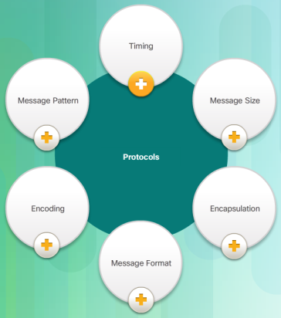
Principles of Communications Establishing the Rules
The Three Elements
The source, the destination, and the transmission medium.
Communication Protocols
Before beginning to communicate with each other, we establish rules or agreements to govern the conversation.
Why Protocols Matter
Networking protocols define the rules of communication over the local network.
Notes:
3.1 – Principles of Communications
3.1.1 – Establishing the Rules

Slide 12

Principles of Communications So Who Makes the Rules
The Internet and Standards
A standard is a set of rules that determines how something must be done.
Networking protocols and Internet standards make it possible for different types of devices to communicate over the Internet.
Network Standards Organizations
Standards are developed, published, and maintained by a variety of organizations.
Notes:
3.1 – Principles of Communications
3.1.2 – So Who Makes the Rules

Slide 13
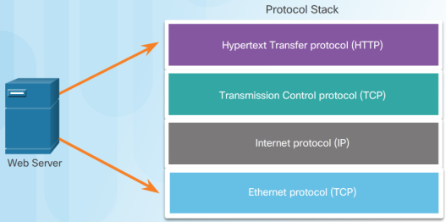
Principles of Communications Visualizing How Protocols Work
Stacking Them Up
Successful communication requires interaction between protocols.
A protocol stack is used to help separate the function of each protocol.
This enables each layer in the stack to operate independently of others.
Using a Layered Model
Layered models help us visualize how the various protocols work together to enable network communications
Notes:
3.1 – Principles of Communications
3.1.3 – Visualizing How Protocols Work

Slide 14
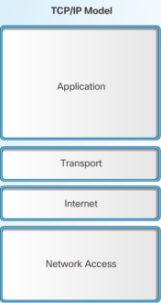
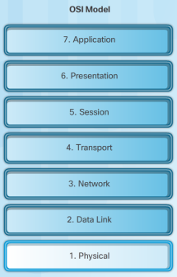
Principles of Communications Visualizing How Protocols Work
Different types of Network Models
Protocol Model | Reference Model
TCP/IP Model | Open Systems Interconnection (OSI) Model
Notes:
3.1 – Principles of Communications
3.1.3 – Visualizing How Protocols Work

Slide 15
3.2 Talking the Language of Networking
Notes:
Cisco Networking Academy Program
Networking Essentials
Chapter 3: Communicating on a Local Network

Slide 16
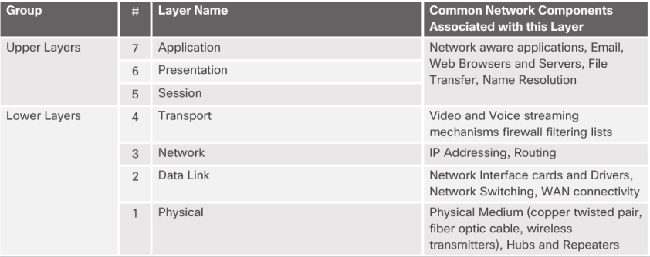
Talking the Language of Networking Working with the OSI Model
Dividing the Tasks
The OSI model divides communication into multiple processes.
Each process is a small part of the larger task.
Notes:
3.2 – Talking the Language of Networking
3.2.1 – Working with the OSI Model

Slide 17
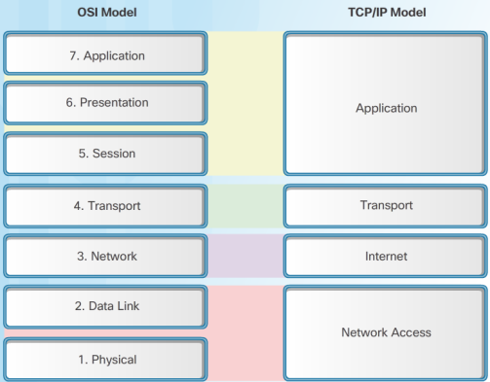
Talking the Language of Networking Working with the OSI Model
Comparing the OSI and TCP/IP Models
Both models are commonly used; therefore, it is wise to become very familiar with them.
Notes:
3.2 – Talking the Language of Networking
3.2.1 – Working with the OSI Model

Slide 18
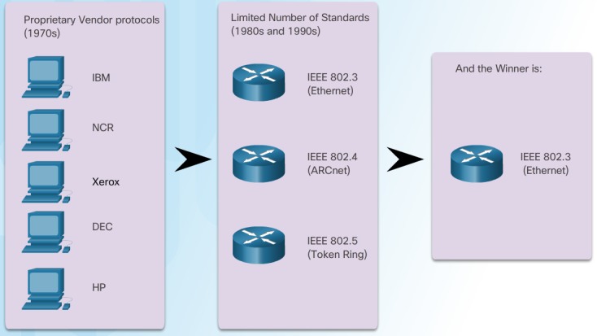
Talking the Language of Networking Protocols for Wired Networks
Why Ethernet?
Ethernet has become the de facto standard
This means it is used by almost all wired local area networks
Notes:
3.2 – Talking the Language of Networking
3.2.2 – Protocols for Wired Networks

Slide 19
Talking the Language of Networking Protocols for Wired Networks
Ethernet is Constantly Evolving
The Institute of Electrical and Electronic Engineers (IEEE) maintains Ethernet and wireless standards.
They are responsible for maintaining the standards and for approving new enhancements.
Ethernet Addressing
Each host connected to an Ethernet network is assigned a unique physical address which identifies it on the network.
The physical address is known as the Media Access Control (MAC) address and is assigned to a NIC it when it is manufactured.
Notes:
3.2 – Talking the Language of Networking
3.2.2 – Protocols for Wired Networks

Slide 20
3.3 How do Ethernet Networks Work?
Notes:
Cisco Networking Academy Program
Networking Essentials
Chapter 3: Communicating on a Local Network

Slide 21
How do Ethernet Networks Work? Preparing Data for Transmission
Encapsulation
The process of placing one message inside another message format is called encapsulation.
De-encapsulation occurs when the process is reversed.
Before a network message is sent over the network, it is encapsulated in a frame that identifies the destination and source MAC addresses.
Framing the Message
IEEE 802.3 Ethernet Frame
7 bytes | 1 | 6 | 6 | 2 | 46 to 1500 | 4
Preamble | Start of Frame Delimiter | Destination MAC Address | Source MAC Address | Type / Length | 802.2 Header and Data | Frame Check Sequence
Notes:
3.3 – How do Ethernet Networks Work?
3.3.1 – Preparing Data for Transmission

Slide 22
How do Ethernet Networks Work? The Building Blocks of Ethernet Networks
Why Networks Need Hierarchical Design
A MAC address identities a specific host on a local network, but it cannot be used to reach remote hosts networks.
A hierarchical design is required.
The Benefits of Hierarchical Design
Enterprise networks are most often designed in hierarchical manner using an access layer, distribution layer, and core layer.
Hierarchical networks require a logical addressing scheme such as Internet Protocol version 4 (IPv4) or Internet Protocol version 6 (IPv6) to reach remote hosts.
Notes:
3.3 – How do Ethernet Networks Work?
3.3.2 – The Building Blocks of Ethernet Networks

Slide 23
How do Ethernet Networks Work? Logical Addressing
Physical and Logical Addresses
A MAC address is physically assigned to a NIC and never changes.
The physical MAC address remains the same regardless of network.
An IP address (network address) is logically assigned to a host NIC.
The logical IP addresses contain two parts:
Network portion: The left-hand portion of an IP address identifies the network portion of the address. It is the same for all hosts connected to the local network.
Host address: The right-hand portion of an IP address that uniquely identifies the individual host on the network.
Both the physical MAC and logical IP addresses are required for a computer to communicate on a hierarchical network.
Notes:
3.3 – How do Ethernet Networks Work?
3.3.3 – Logical Addressing

Slide 24
3.4 How are Networks Built?
Notes:
Cisco Networking Academy Program
Networking Essentials
Chapter 3: Communicating on a Local Network

Slide 25
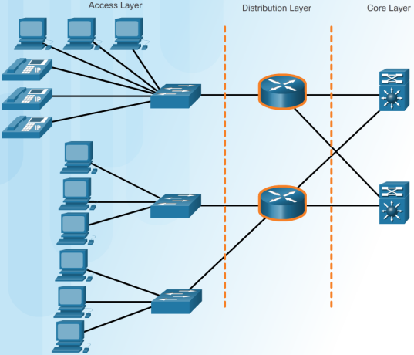
How are Networks Built? Starting with a Good Design
Interconnects the smaller local networks.
Access, Distribution and Core
Provides a high-speed connection between distribution layer devices
Provides connections to hosts in a local Ethernet network.
Notes:
3.4 – How are Networks Built?
3.4.1 – Starting with a Good Design

Slide 26
How are Networks Built? Starting with a Good Design
Access Layer Devices
Provides the first line of networking devices that connect hosts to the wired Ethernet network.
Typically connected using Layer 2 switches.
Ethernet Hubs
Legacy access layer device that broadcast frames to all ports.
Created excessive collision domains.
Hubs have been superseded by Layer 2 switches.
Notes:
3.4 – How are Networks Built?
3.4.1 – Starting with a Good Design

Slide 27
How are Networks Built? Building a Better Access Layer
Ethernet Switches
A switch accepts and decodes the frames to read the physical (MAC) address portion of the message.
The switch checks a table on the switch, called a MAC address table, that contains a list of all of the active ports and the host MAC addresses that are attached to them.
The switch creates a circuit that connects those two ports, enabling the switch to support multiple conversations between different pairs of ports.
Notes:
3.4 – How are Networks Built?
3.4.2 – Building a Better Access Layer

Slide 28
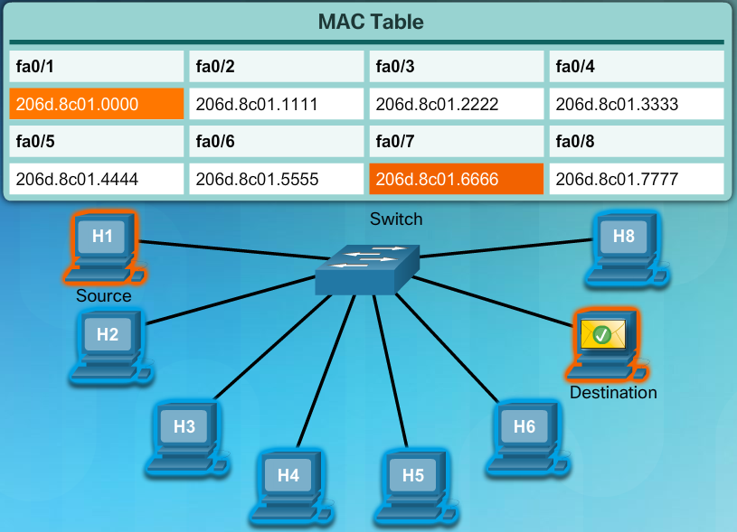
How are Networks Built? Building a Better Access Layer
MAC Address Tables
Notes:
3.4 – How are Networks Built?
3.4.2 – Building a Better Access Layer

Slide 29
How are Networks Built? Containing Broadcasts
What are Broadcasts Anyway?
A broadcast message is simultaneously sent by a host to all other hosts.
A broadcast MAC address in hexadecimal notation is FFFF.FFFF.FFFF
Broadcast Domains
A local area network, a network with one or more Ethernet switches, is also referred to as a broadcast domain.
When a broadcast message is sent, all switches forward the message to every connected host within the same local network.
Notes:
3.4 – How are Networks Built?
3.4.3 – Containing Broadcasts

Slide 30
How are Networks Built? Containing Broadcasts
Communicating at the Access Layer
To send a message, a host needs the IP address and MAC address of the destination host.
The destination IP address is typically known; therefore, how does the sending host determine the destination MAC address?
The sending host can use an IPv4 protocol called address resolution protocol (ARP) to discover the MAC address of any host on the same local network.
IPv6 uses a similar method known as Neighbor Discovery.
Notes:
3.4 – How are Networks Built?
3.4.3 – Containing Broadcasts

Slide 31

How are Networks Built? Containing Broadcasts
How ARP Works
Send data to a device
The PC attempts to ping IP address 10.1.1.1.
PC> ping 10.1.1.1
Is the MAC address in my ARP cache?
Send an ARP Request to IP 10.1.1.1
No
Dest MAC: FF-FF-FF-FF-FF-FF
The PC requires the destination IP address and MAC address.
Yes
Send ping packet
Receive ARP Reply from 10.1.1.1 with its MAC address
Notes:
3.4 – How are Networks Built?
3.4.3 – Containing Broadcasts

Slide 32
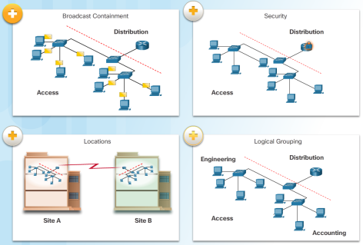
How are Networks Built? Distributing Messages to Other Devices
Dividing the Local Network
As networks evolve, it is necessary to divide one access layer network into multiple access layer networks.
There are many ways to divide networks based on different criteria.
Now We Need Routing
Routers and routing is required to reach remote hosts.
Routing is the process of identifying the best path to a destination.
Notes:
3.4 – How are Networks Built?
3.4.4 – Distributing Messages to Other Devices

Slide 33
3.5 Routing Across Networks
Notes:
Cisco Networking Academy Program
Networking Essentials
Chapter 3: Communicating on a Local Network

Slide 34
Routing Across Networks Keeping a Table
Selecting a Path
Every router creates a routing table containing all locally-connected and remote networks and the interfaces that connect to them.
Routers use their routing tables and forward packets to either a directly connected network containing the actual destination host, or to another router on the path to reach the destination host.
Building the Tables
Router build their routing tables by first adding their locally connected networks, and then learning about other networks using routing protocols.
Notes:
3.5 – Routing Across Networks
3.5.1 – Keeping a Table

Slide 35
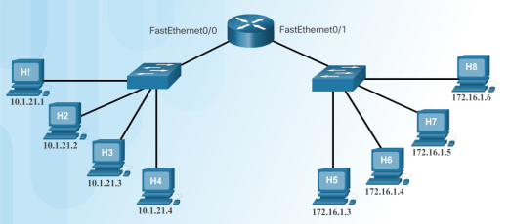
Routing Across Networks Keeping a Table
Type | Network | Outgoing Port
C | 10.1.21.0/24 | FastEthernet 0/0
C | 172.16.1.0/24 | FastEthernet 0/1
How Routers Use Tables
The router has added its two directly connected networks to the routing table.
Sending to Remote Networks
If H1 sent a packet to H7, the router would examine its routing table and determine that to reach network 172.16.1.0/24 , it must forward the packet out of its Fa0/1 interface.
Because the outgoing network is a directly connected Ethernet network, the router may also have to ARP the IP address.
Notes:
3.5 – Routing Across Networks
3.5.1 – Keeping a Table

Slide 36
Routing Across Networks Creating a LAN
Local Area Networks
Local Area Network (LAN) refers to a local network, or a group of interconnected local networks that are under the same administrative control.
The term Intranet refers to a private LAN that belongs to an organization, and is accessible only by the organization's members, employees, or others with authorization.
Notes:
3.5 – Routing Across Networks
3.5.2 – Creating a LAN

Slide 37
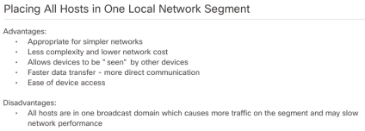
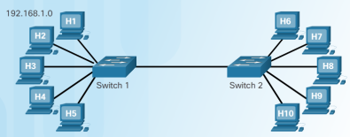
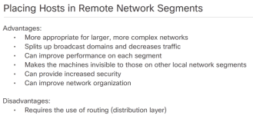
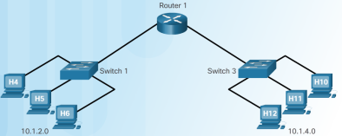
Routing Across Networks Creating a LAN
Assigning Hosts to a LAN
Notes:
3.5 – Routing Across Networks
3.5.2 – Creating a LAN

Slide 39


